Slide 1

Generative AI Powered Voice Assistant Customer Service for Rogers
Group CP5:
Rakesh Mahendranath
Govind Kala Raveendran
Charumathi Sathish
Aiswarya Raj
Het Chandubhai Patel
Vignesh Ramasubramanian

Slide 2

Executive Summary
Objective: Implement an AI-powered voice assistant customer service platform for Rogers Communications Inc.
Success Criteria: Improved customer service experience, reduced handling time, ensured accuracy, minimized escalations, and cut costs.
Approach:
Defined project scope and objectives.
Gathered requirements from stakeholders.
Analyzed current customer service challenges.
Researched AI-powered solutions.
Prepared business and solution requirement documents.
Evaluated feasibility and ROI.
Designed implementation and testing strategies.
Deployed AI-powered platform.

Slide 3
Competitive Analysis
Internal Strength | Internal Weaknesses
Financial stability and strong balance sheet. Canadian-based call centers for enhanced customer satisfaction. Ownership of media properties and sports rights. Strong brand image and customer loyalty. | Lack of presence in the US compared to Verizon. Limited fiber-optic network compared to other networks.(TELUS) Lagging media unit profitability.
External Opportunities | External Threats
Leverage media properties through partnerships. Expand market share in Western Canada. Acquisition Potential (Shaw Communications). Promote the Connected for Success program. | Competition from BELL and TELUS in cellular market. Rising expenses for advanced networks. Government regulations impacting operations. Economic weakness affecting consumer spending.
(References Added Below)

Slide 4
Team Members and their Responsibility
Name and Signature | Role | Organization | Contact Information
Nilesh Deshmukh | Sponsor | Rogers | +1(519)-819-xxxx
Aiswarya Raj | Project Manager | Catalyst | +1(226)-579-xxxx
Rakesh Mahendranath | Assistant Project Manager | Catalyst | +1(519)-156-xxxx
Govind Kala Raveendran | Business Analyst | Catalyst | +1(456)-720-xxxx
Charumathi Sathish | Business Analyst | Catalyst | +1(411)-861-xxxx
Vignesh Ramasubramanian | Business Analyst | Catalyst | +(519)-765-xxxx
Het Chandu Bhai Patel | Business Analyst | Catalyst | +(226)-581-xxxx

Slide 5
Problem Statement
Increased Operational Costs
Inconsistent Customer Experience
Longer Resolution Times
Limited Scalability
Inefficient Resource Allocation

Slide 6
Business Requirements
Customer Service Context Handling
Integration with Existing Systems
Customer Service KPIs Tracking
Privacy and Security Standards
Language Support
Consistent and Accurate Responses
User Load and Scalability Requirements

Slide 7
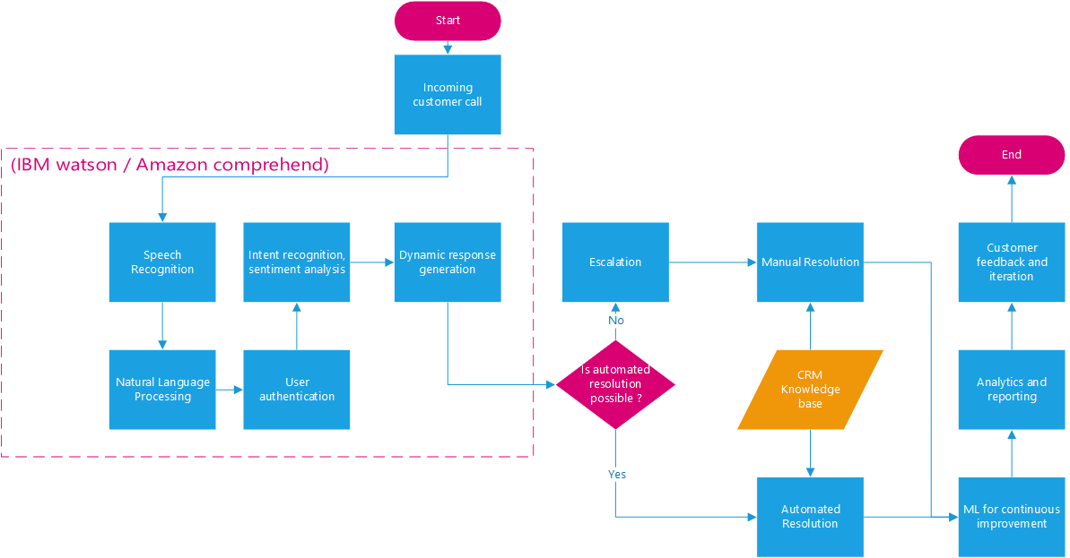
To-be process flow

Slide 8
Evaluation criteria
People
Performance
Proactive
Intuitive
Responsive
Process
Technology
Adaptability
Empathy
UI/UX
Efficiency
Automation
Flexibility
Scalability
Reliability
Incident Management
Knowledge Management
Quality Assurance
Compliance
Security
Availability
Data Specification
Encryption
Backup Mechanisms
Disaster Recovery Planning
Speech Recognition Accuracy
Natural Language Understanding
API Accessibility

Slide 9
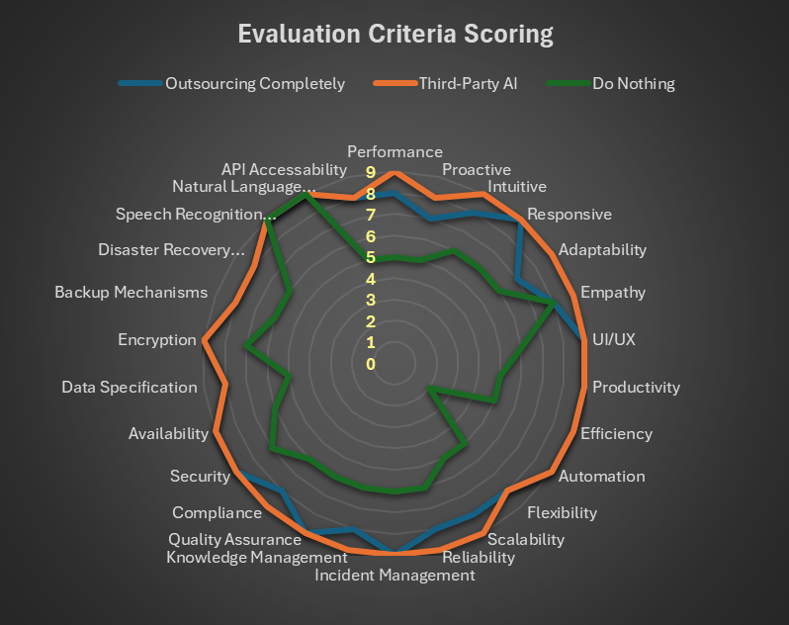
Solution Recommendation
Solution Options & Scores
Outsourcing Completely – 218
Third-Party AI Product – 228
Do Nothing – 154
Recommended: Third-Party AI Product
Enhanced Customer Experience
Improved Operational Efficiency and Productivity
Scalable and Reliable Infrastructure
Comprehensive Security and Compliance
Better Customization and Integration

Slide 10
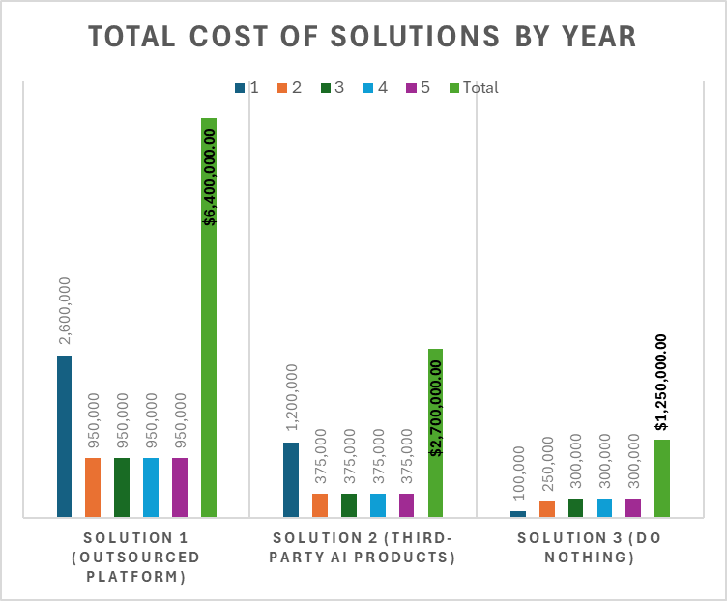
ROI (Return on Investment)
Cost Category | Years | S1: Outsourced Platform | S2: Third-Party AI Products
Implementation | 1 | $1,500,000 | $750,000
 | 2-5 | $0 | $0
Licensing | 1-5 | $500,000/year | $200,000/year
Maintenance | 1-5 | $300,000/year | $100,000/year
Enhancement | 1-5 | $100,000/year | $50,000/year
Training | 1 | $200,000 | $100,000
 | 2-5 | $50,000/year | $25,000/year

Slide 11
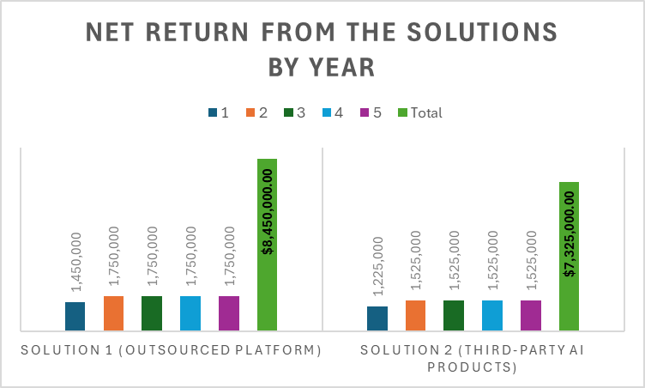
ROI (Contd.)
Net Returns Expected | Years | S1: Outsourced Platform | S2: Third-Party AI Products
Increased Customer Satisfaction | 1-5 | $500,000/year | $500,000/year
Reduced Customer Churn | 1-5 | $500,000/year | $500,000/year
Increased Agent Efficiency | 2-5 | $300,000/year | $300,000/year
Operational benefit | 1-5 | $450,000/year | $225,000/year

Slide 12
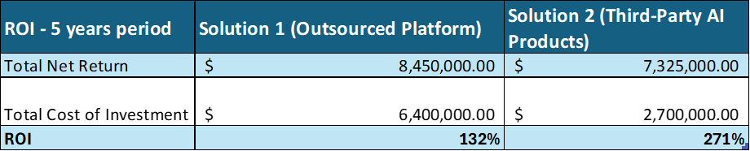
ROI (Contd.)
Third-party AI products offer the highest return on investment over the five years, making it the most cost-effective option.
Integration of third-party AI solutions is the optimal choice for Rogers to enhance its customer service call system.

Slide 13
Implementation Strategy
Phased Deployment: Testing and feedback in stages.
Components:
Migration Plan
Support and closure
Engagement and Training
Backout Strategy.

Slide 14
Migration Plan
PHASE 1 : Pilot
Subset of calls handled by AI.
Feedback for model refinement.
PHASE 2 : Departmental Rollout
AI rollout to departments.
Targeted training and support.
PHASE 3 : Full Deployment
Implement AI across all channels.
Detailed release schedule.
Phase 1 : Pilot
Phase 2: Departmental Rollout
Phase 3: Full Deployment
Notes:
1

Slide 15
Support and Closure
Dedicated support
Early Life Support: Post-deployment assistance.
Incident Management: Swift issue resolution
Release Closure: Officially close phases
Post-Implementation Review

Slide 16
Engagement and Training
Client Engagement: Regular updates and milestones
Extensive Training: End Users, administrators and support staff
Continuous Learning: Webinars, workshops.

Slide 17
Backout strategy
Backout Plan: Detailed procedure for reverting changes.
Testing Backout: Ensure practicality during testing.
Communication Protocol: Clear channels for execution.
Monitoring and Evaluation: Continuous monitoring and feedback.
Post-Backout Review

Slide 18
Continuous Improvement
Post-Deployment Process: Adaptation to evolving needs.
Regular Reviews: Based on feedback.

Slide 19
Test Strategy
Testing types
Unit Testing
Entry Criteria: Completed code, test cases for critical functionalities
Exit Criteria: Successful completion, 80% code coverage
Integration Testing
Entry Criteria: Completed unit testing, integrated test environment
Exit Criteria: 70% test coverage, 0 critical defects
UAT
Entry Criteria: MVP ready
Exit Criteria: 80% stakeholder acceptance
Performance Testing
Entry Criteria: Completed integration testing
Exit Criteria: Meet performance objectives, system stability under load
Security Testing
Entry Criteria: Completed integration testing
Exit Criteria: No critical vulnerabilities, compliance with security standards

Slide 20
Test Strategy (Contd.)
Test Environment
Development
Integration
UAT
Tools
Jira
OWASP ZAP
Apache JMeter
Test sign-off
After each phase
Verification of exit criteria
(References Added Below)
Notes:
References:
https://stuconestogacon-my.sharepoint.com.mcas.ms/:w:/r/personal/gkalaraveendran9759_conestogac_on_ca/_layouts/15/Doc.aspx?sourcedoc=%7B334EF17D-008C-4FCF-9F5C-E14AA46208E7%7D&file=W23-QUAL8686-GroupCP5-FinalReport_1.docx&action=default&mobileredirect=true

Slide 21
Thank you.
Notes:
References:
https://stuconestogacon-my.sharepoint.com.mcas.ms/:w:/r/personal/gkalaraveendran9759_conestogac_on_ca/_layouts/15/Doc.aspx?sourcedoc=%7B334EF17D-008C-4FCF-9F5C-E14AA46208E7%7D&file=W23-QUAL8686-GroupCP5-FinalReport_1.docx&action=default&mobileredirect=true

